Slide 1
Student Management System
B.Hemanth -1602-20-737-073
N.Naveen Reddy -1602-20-737-086
M.Nikhitha -1602-20-737-087

Slide 2
Abstract
Student management system can handle all the details about a student. The detail includes student personal details, academic details etc.
Student management system is a management information system for educational establishments to manage Student data.
It provides capability for registering students, admitted students tracking student attendance, displaying their marks and their fee status.
Faculty & Student will have their login credentials .
Ensure data integrity, privacy and security in an open access environment.
It uses low requirements on the end user system and simplified architecture.
For saving the students data we have used MySQLite3 database.

Slide 3
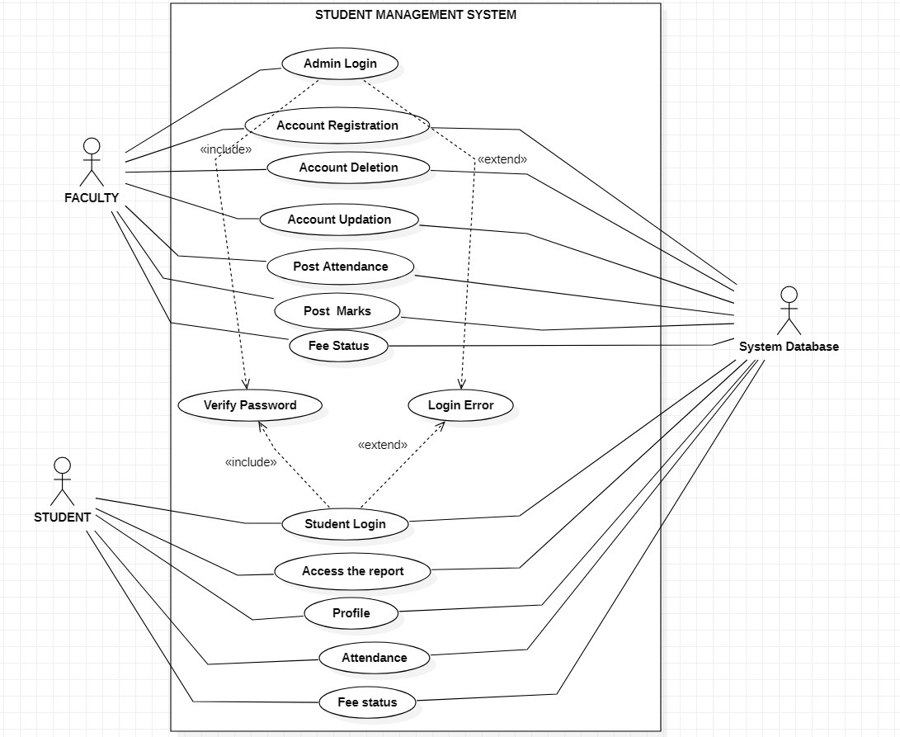
Use Case Diagram :

Slide 4
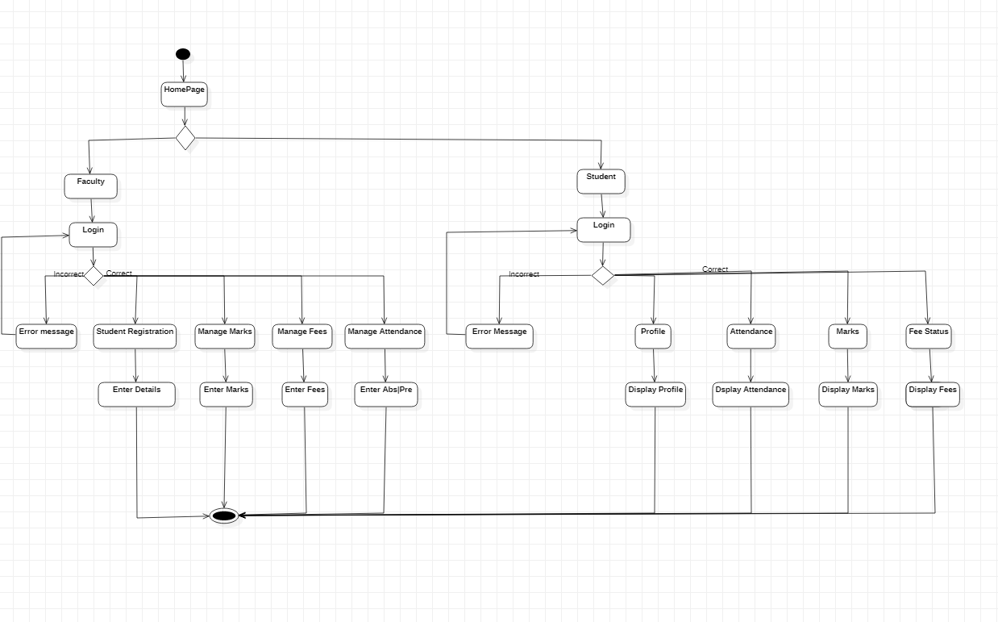
Activity Diagram :

Slide 5
Technology Used :
Tkinter
Sqlite3
Qr code
PIL

Slide 6
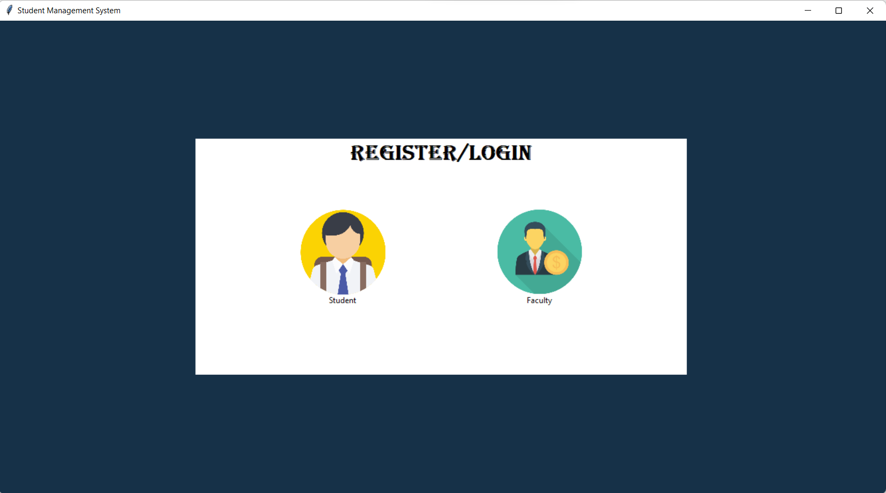
ScreenShot of Execution :

Slide 7
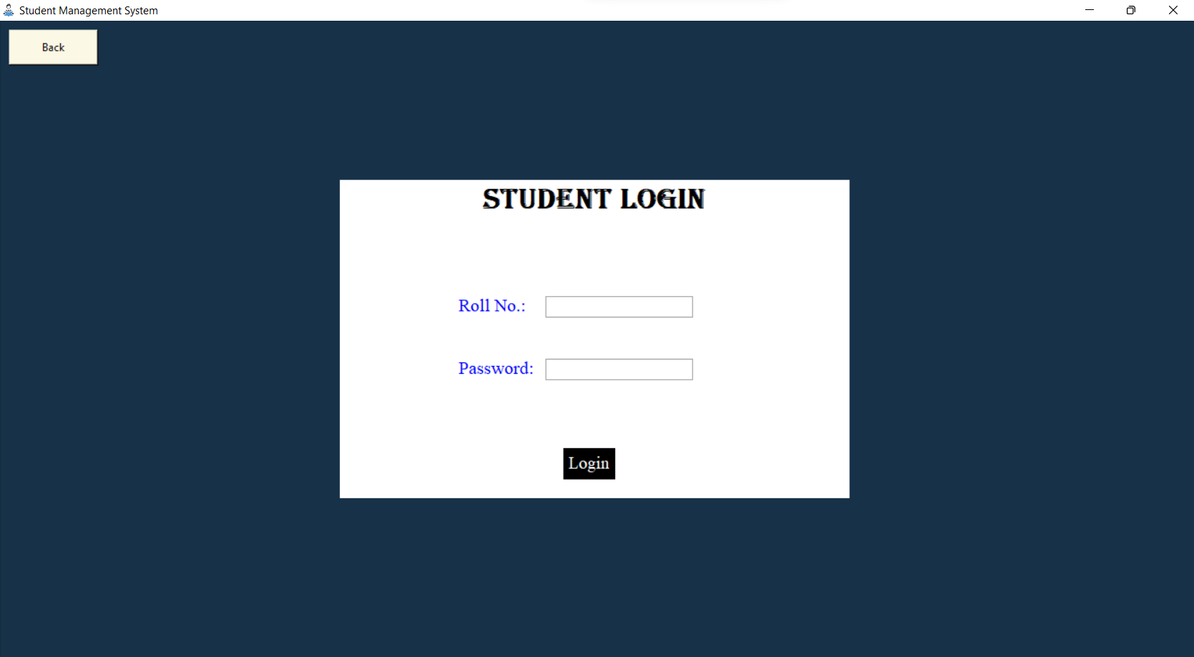
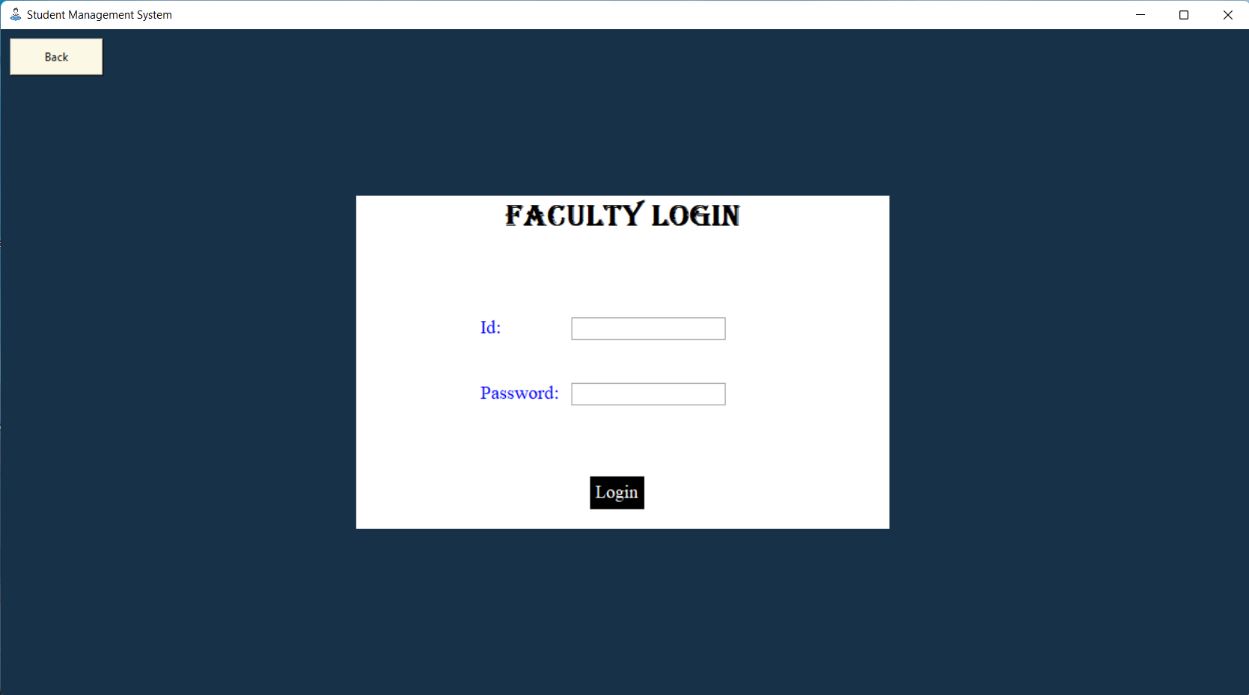
ScreenShot of Execution :

Slide 8
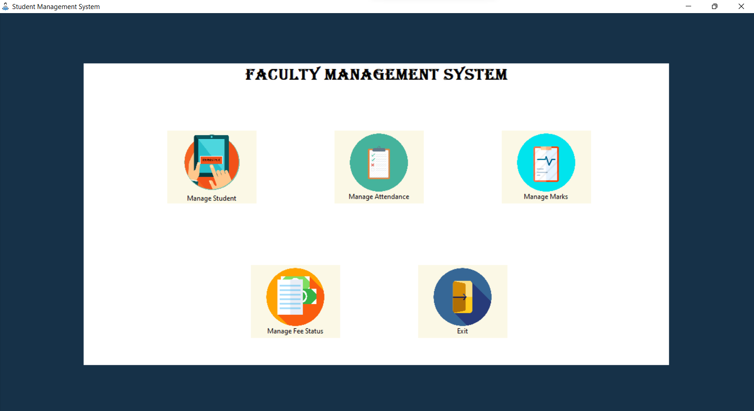
ScreenShot of Execution (Faculty Module)

Slide 9
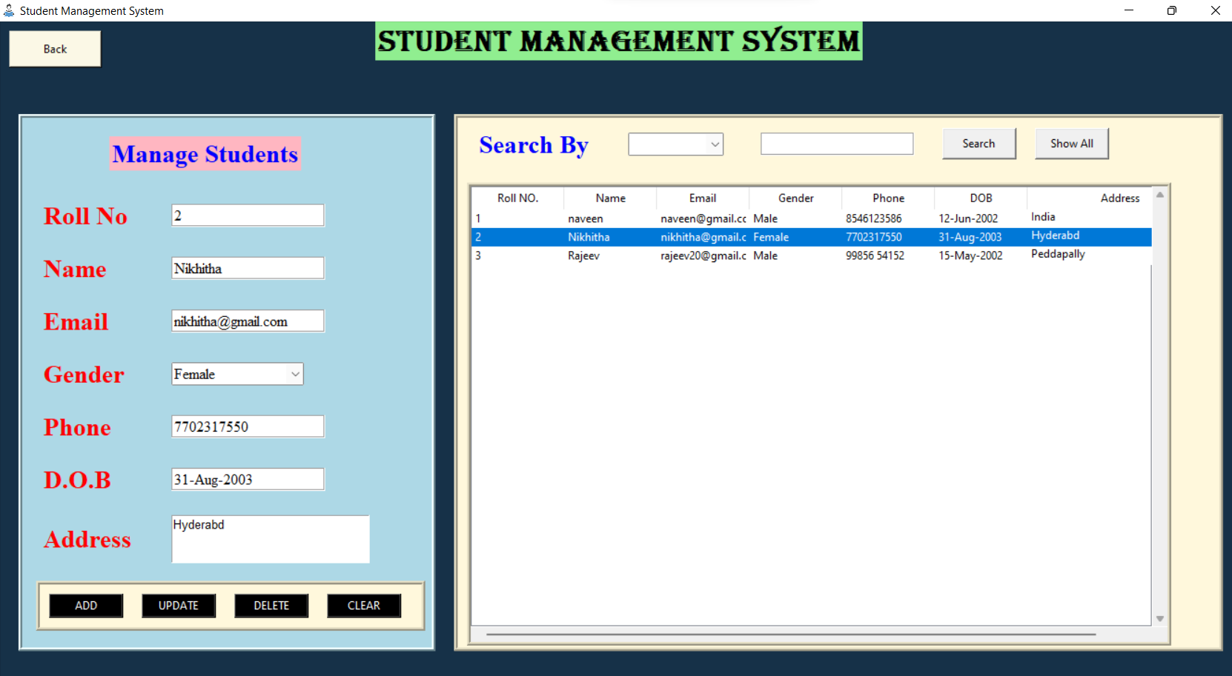
ScreenShot of Execution (Manage Student)

Slide 10
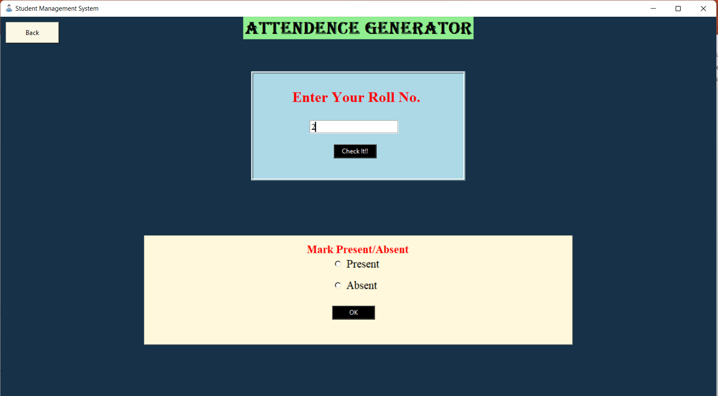
ScreenShot of Execution (Attendance Management)

Slide 11
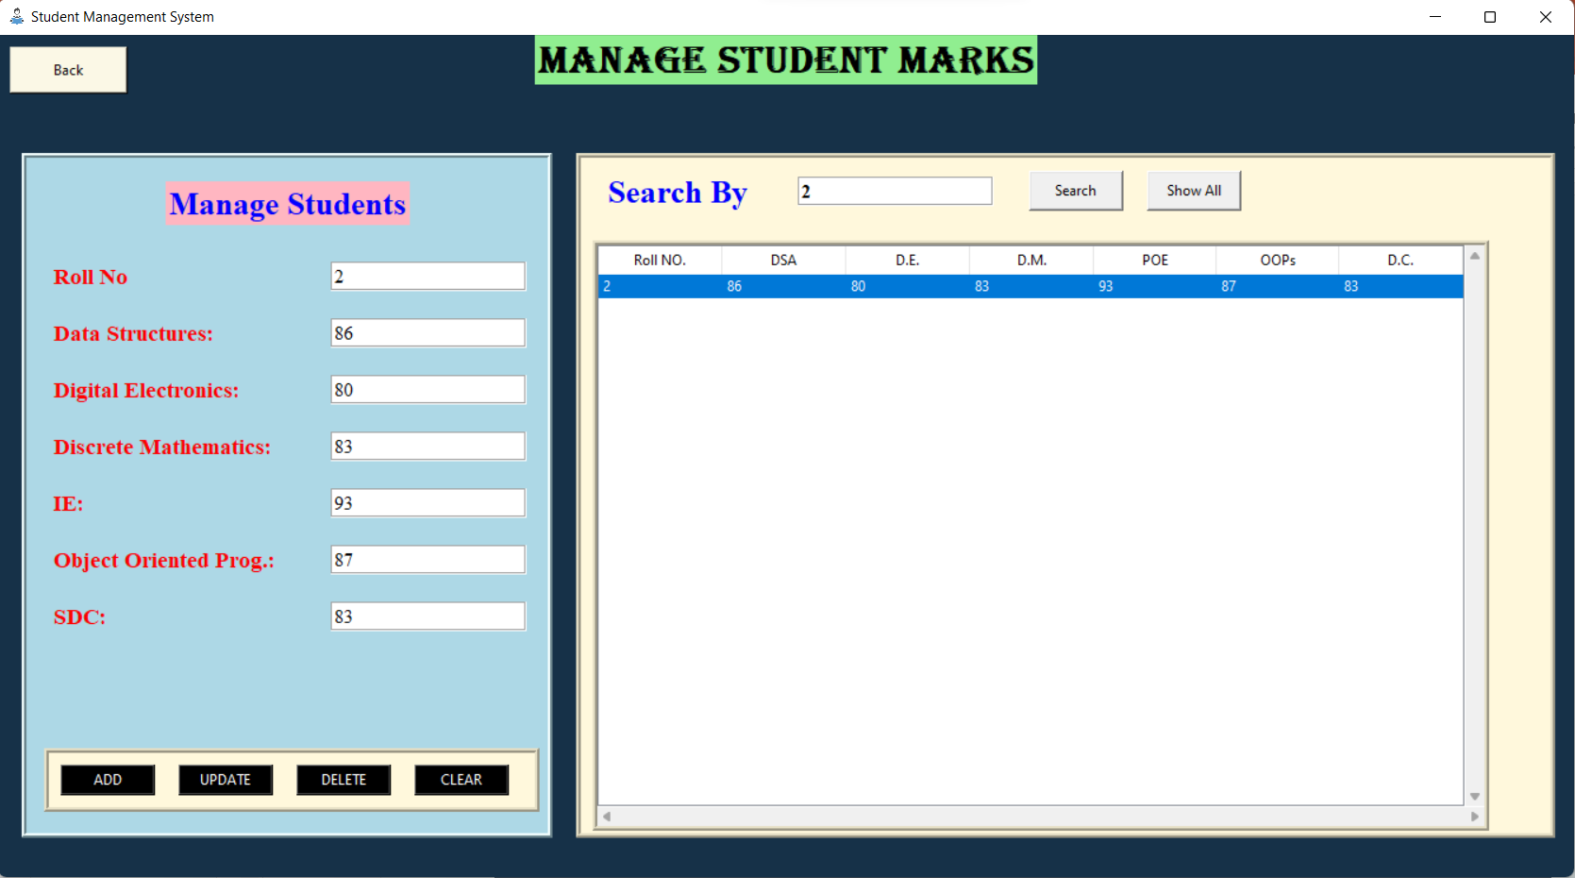
ScreenShot of Execution (Manage Marks)

Slide 12
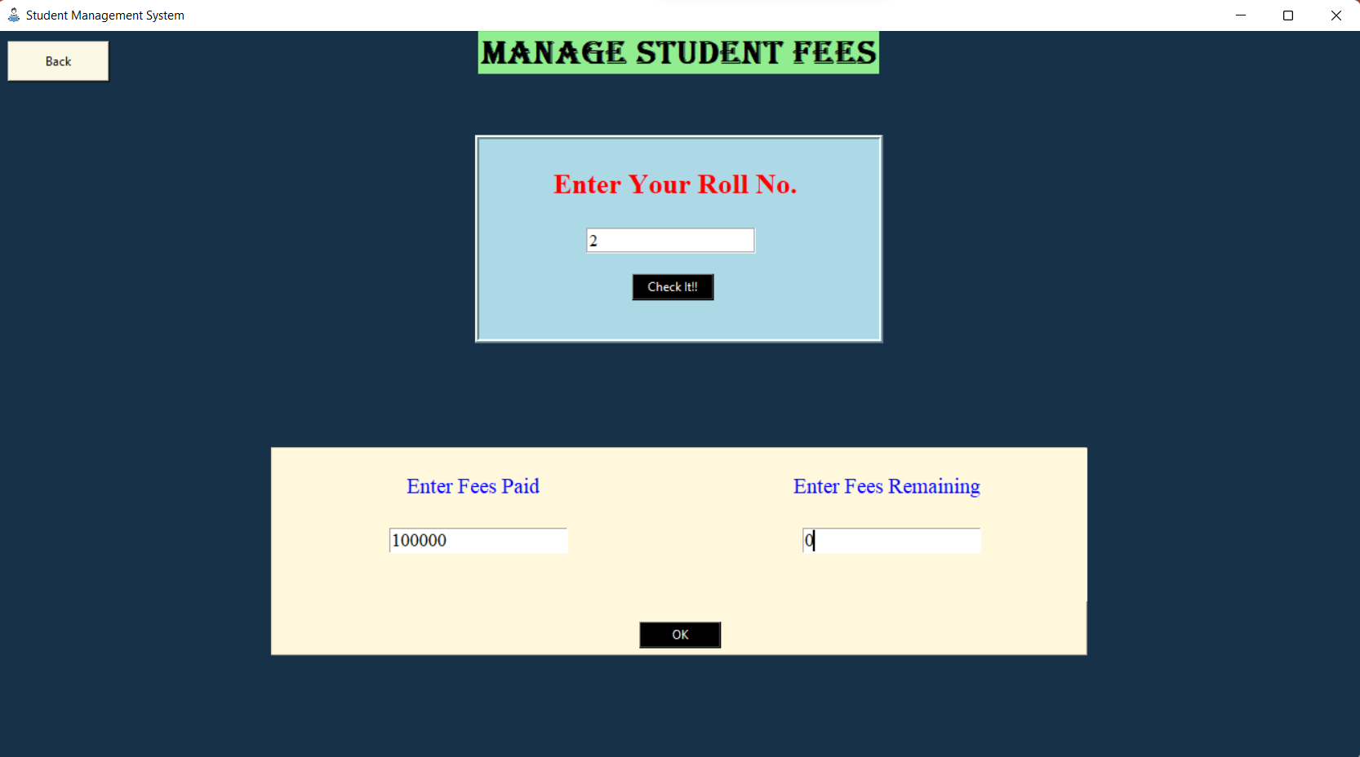
ScreenShot of Execution (Manage Marks)

Slide 13
ScreenShot of Execution (Manage Marks)

Slide 14
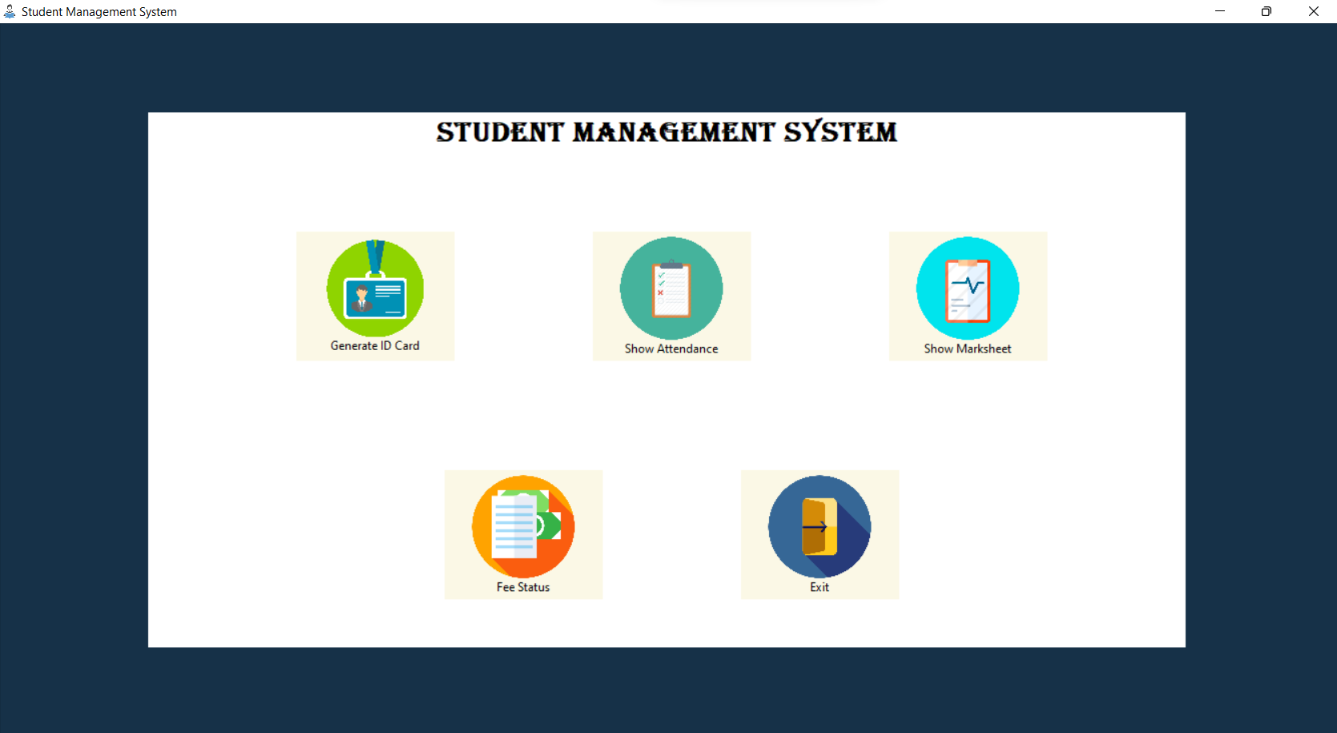
ScreenShot of Execution (Student Module)

Slide 15
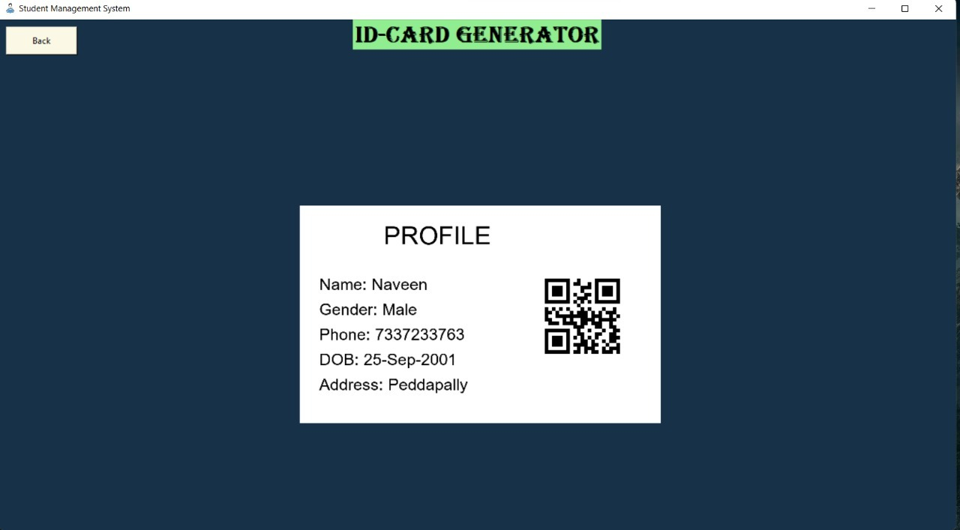
ScreenShot of Execution (ID card)

Slide 16
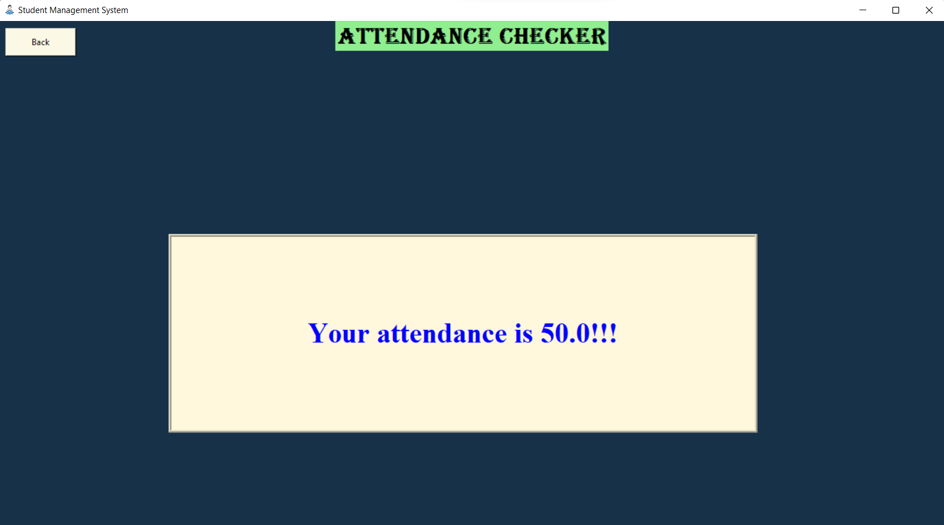
ScreenShot of Execution : (Show Attendance)

Slide 17
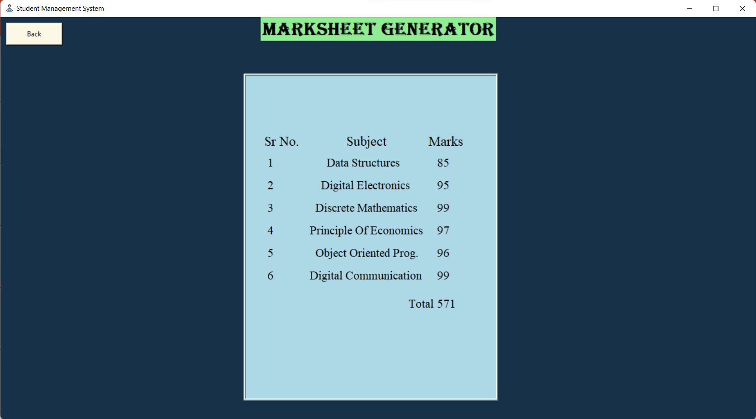
ScreenShot of Execution (Show Marksheet)

Slide 18
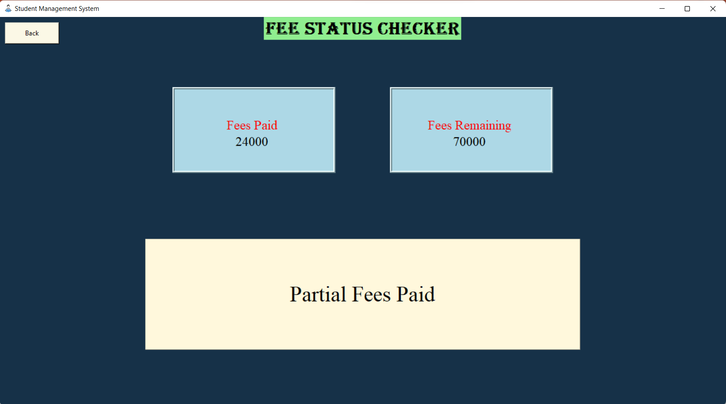
ScreenShot of Execution (Fee status)

Slide 19
Conclusion & Future Scope
Thus, this is the python based GUI project which shows the functionality of student management system developed with the help of tkinter, PIL, sqlite3 and qrcode.
We can enhance it by making the same project to work on Internet
We can add some more modules based on future security issues & can be improved by using emerging technologies.

Slide 20
Thank you

